Slide 1
Sources of Energy
CHAPTER 14
PART 2- Conventional Sources of Energy
Notes:
Lets start with our Chapter 1- that is Chemical Reactions and Equations

Slide 2
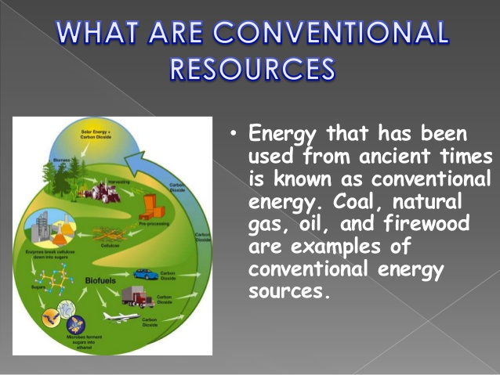
Conventional Sources of Energy
Conventional sources of energy are the ones that cannot be renewed.
Notes:
The Definition of Conventional Sources of energy is,
Sources of energy are the ones that cannot be renewed.
There are three Conventional Sources of energy that we will be looking into..
Fossil Fuels
Thermal Power Plant
Hydro Power Plants

Slide 3
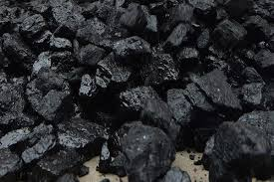
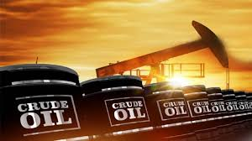
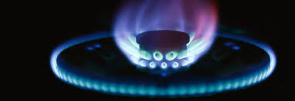
FOSSIL FUELS
Fossil fuel is a general term for buried combustible geologic deposits of organic materials, formed from decayed plants and animals that have been converted to crude oil, coal, natural gas, or heavy oils by exposure to heat and pressure in the earth's crust over hundreds of millions of years.
Fossil fuels have 3 major types:
Coal, oil and natural gas
Notes:
Let us understand a little bit about each of the 3 types of conventional sources of energy
First,
Fossil fuel is a general term for buried combustible geologic deposits of organic materials, formed from decayed plants and animals that have been converted to crude oil, coal, natural gas, or heavy oils by exposure to heat and pressure in the earth's crust over hundreds of millions of years.
There are three major types of fossil fuels:
Coal is formed from ferns, plants and trees which hardened due to pressure and heat
Oil is formed from smaller organisms, like zooplankton and algae. Intense amounts of pressure caused this complex organic matter to decompose into oil.
Natural Gas undergoes the same process as oil; however the process is longer and subject to higher amounts of heat and pressure, causing further decomposition.

Slide 4
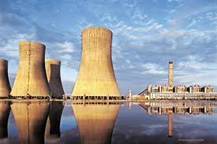
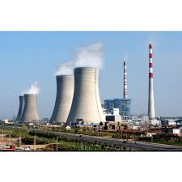
THERMAL POWER PLANTS
In thermal power plants, the heat energy obtained from combustion of solid fuel (mostly coal) is used to convert water into steam, this steam is at high pressure and temperature.
This steam is used to rotate the turbine blade turbine shaft is connected to the generator. The generator converts the kinetic energy of the turbine impeller into electric energy.
Notes:
Moving on to thermal energy… the Thermal power plant
Its working is like..
Coal: In a coal based thermal power plant, coal is transported from coal mines to the generating station. The coal from live storage is first crushed in small particles and then taken into pulverizer to make it in powdered form. Fine powdered coal undergoes complete combustion, and thus pulverized coal improves efficiency of the boiler. The ash produced after the combustion of coal is taken out of the boiler furnace and then properly disposed. Periodic removal of ash from the boiler furnace is necessary for the proper combustion.
Boiler: The mixture of pulverized coal and air (usually preheated air) is taken into boiler and then burnt in the combustion zone. On ignition of fuel a large fireball is formed at the center of the boiler and large amount of heat energy is radiated from it. The heat energy is utilized to convert the water into steam at high temperature and pressure.
Steam turbine:High pressure super heated steam is fed to the steam turbine which causes turbine blades to rotate.
The pressure and temperature of the steam falls to a lower value and it expands in volume as it passes through the turbine. The expanded low pressure steam is exhausted in the condenser.
Condenser:The exhausted steam is condensed in the condenser by means of cold water circulation. Here, the steam loses it's pressure as well as temperature and it is converted back into water.
Alternator: The steam turbine is coupled to an alternator. When the turbine rotates the alternator, electrical energy is generated.
Feed water pump: The condensed water is again fed to the boiler by a feed water pump. Some water may be lost during the cycle, which is suitably supplied from an external water source.

Slide 5
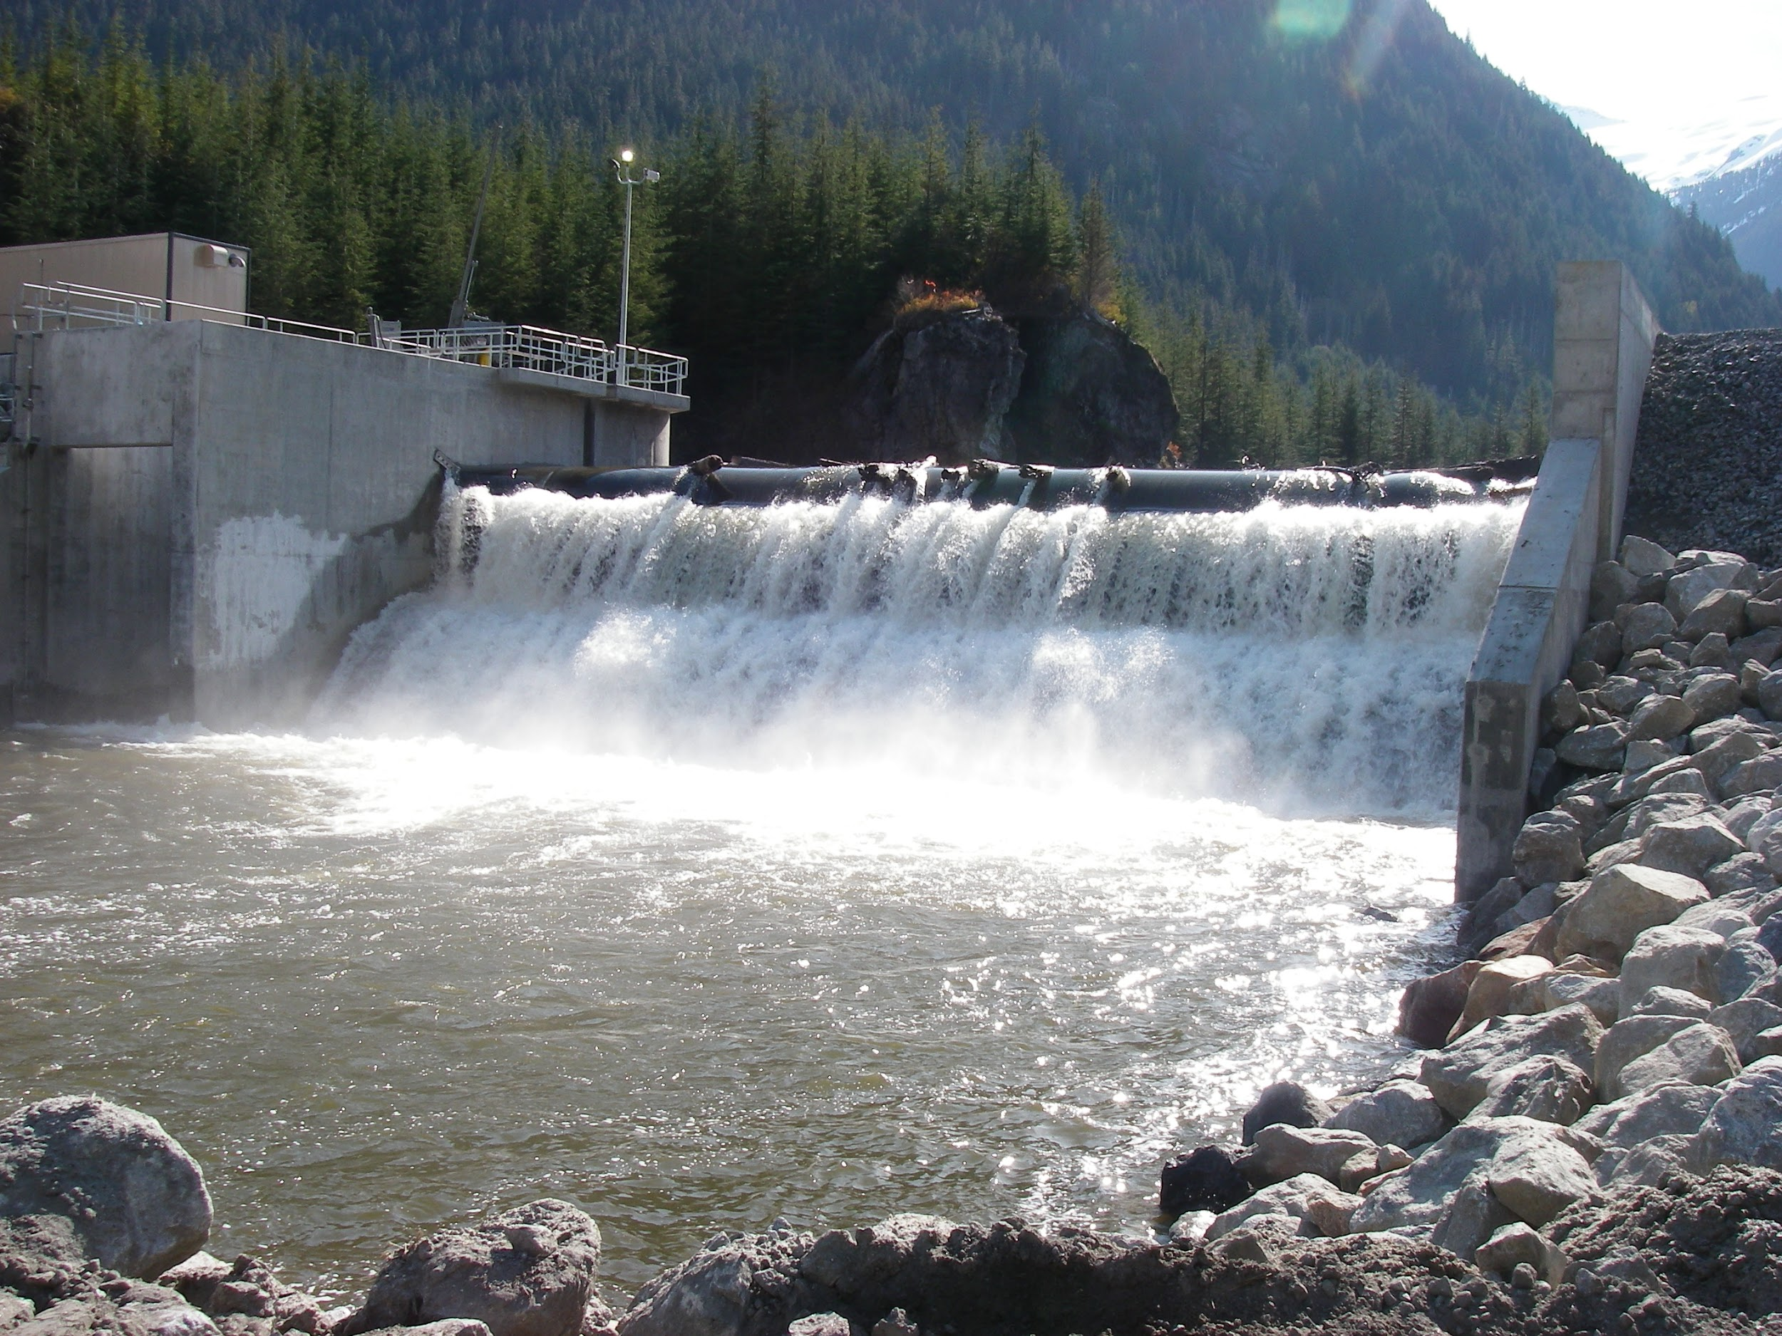
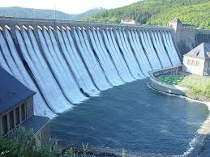
HYDRO POWER PLANTS
Hydropower plants capture the energy of falling water to generate electricity.
Basically, hydro= water
This is obtained by capturing the energy of falling water to generate energy
Notes:
Most conventional hydroelectric plants include four major components (see graphic below):
Dam. Raises the water level of the river to create falling water. Also controls the flow of water. The reservoir that is formed is, in effect, stored energy.
Turbine. The force of falling water pushing against the turbine's blades causes the turbine to spin. A water turbine is much like a windmill, except the energy is provided by falling water instead of wind. The turbine converts the kinetic energy of falling water into mechanical energy.
Generator. Connected to the turbine by shafts and possibly gears so when the turbine spins it causes the generator to spin also. Converts the mechanical energy from the turbine into electric energy. Generators in hydropower plants work just like the generators in other types of power plants.
Transmission lines. Conduct electricity from the hydropower plant to homes and business.

Slide 6
Improvements in the Technology for using Conventional Sources of Energy
BIO-MASS
WIND ENERGY
SOLAR ENERGY

Slide 7
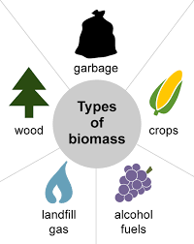
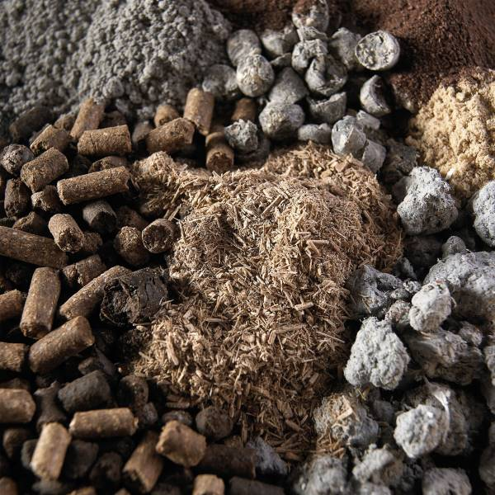
BIO-MASS
Organic input materials such as foodstuff remnants, fats or sludge can be fed into the biogas plant as substrate.
Manure and dung are also fed into the biogas plant.
Notes:
Organic input materials such as foodstuff remnants, fats or sludge can be fed into the biogas plant as substrate.
Manure and dung are also fed into the biogas plant.
In the fermenter, heated to approx. 38-40 °C, the substrate is decomposed by the micro organisms under exclusion of light and oxygen. The final product of this fermentation process is biogas with methane as the main ingredient. But aggressive hydrogen sulphide is also contained in the biogas.
Once the substrate has been fermented, it is transported to the fermentation residues end storage tank and can be retrieved from there for further utilisation.
The residues can be utilised as high quality fertiliser.
The biogas generated is stored in the roof of the tank.
The electric power is fed directly into the power grid.

Slide 8
WIND ENERGY
Wind Energy captures the natural wind in our environment and converts the air’s motion into mechanical energy.
The mechanism used to convert air motion into electricity is referred to as a turbine
Notes:
Wind Energy captures the natural wind in our environment and converts the air’s motion into mechanical energy. Wind is caused by differences in atmospheric pressure. Wind speeds vary based on geography, topography and season. As a result, there are some locations better suited for wind energy generation than others. In general, wind speeds are higher near the coast and offshore since there are fewer objects like vegetation, mountains and buildings to slow them down. ^{[1][2]}
The mechanism used to convert air motion into electricity is referred to as a turbine. A turbine is a large structure with several spinning blades. These blades are connected to an electro-magnetic generator that generates electricity when the wind causes the blades to spin.

